Slide 1
VJ COLLAB
20071A6614 G.Sai Teja
20071A6626 M.Sai Ritish Reddy
20071A6627 M. Uday Krishna
20071A6629 M. Harikesh
Under The Guidance of
Dr. Harshavardhan Awari
Sr. Assistant Professor
CSE- AIML & IOT

Slide 2
ABSTRACT :
Collaboration and discussions among the students are very important during their academic study routine. New ideas, doubts, and discussions help students to learn new concepts. Our team has observed a lack of collaborative nature among peers at the institute level.
Our idea is to create a platform where students from various branches and years can come and collaborate with other students in the institute. The platform would help students collaborate with cross-domain students, provides a place for discussions on new technologies, and also as a forum website for instant solving of technical problems.

Slide 3
Our idea is to create a web application where students from the institute can post discussion queries, and collaboration requests to the application where any other students can comment and respond to the requested queries. The application contains features of an anonymous user, instant queries, comments, closing requested queries.

Slide 4
INTRODUCTION
We are working on a web application in which students from our college can post content regarding collaboration request's and discussion queries related to their projects.
This help the student's to complete their projects, by taking help from other students that is information coming from comment sections and posts etc.
People in a group with a different way of thinking can lead to something better than getting holded with the older ideas.

Slide 5
LITERATURE SURVEY:
Presently collaborative and networking websites such as Quora and LinkedIn serve as a platform for networking among students. These websites are for a greater audience around the world and help people connect globally.
Though these websites are great and work accordingly, users find it hard to collaborate among organizations and universities. Long waiting times to connect and message fellow students in the universities are time-consuming and not efficient when the need is urgent.
When the need is urgent the above networking sites cannot perform well as it is hard to connect through and no guarantee you would get a reply from that specific person. These problems are especially faced by the students when they work on cross-domain projects or team formation for hackathons, etc…

Slide 6
OBJECTIVES :
Communication is the glue that holds together any collaborative environment. Whether that’s regular meetings, setting up a real-time chat tool, or even a message board, there must be a way to disseminate information to everyone quickly and also capture feedback from team members.
Managing tasks is how to get teams working not only collaboratively but more productively. If all these project views are updated with the same real-time data then it allows everyone to work better together with the tools they’re most comfortable with.
Workflow is essential to productivity and works hand-in-glove with task management tools. This lets team members work how they want, managing their workflow.

Slide 7
PROBLEM STATEMENT :
Students who are introverts are facing problems in interacting with other students and work as group. And they cannot discuss their ideas and doubts with others.
This stops new innovation outcomes. Even the students want to work in groups and they may not have any idea about other branch students and their skills.
It’s not possible for a student to be proficient in every domain. To handle projects of cross-domain we need a team of various branches. But, the lack of availability of student information makes it harder to collaborate.

Slide 8
PROPOSED SYSTEM
We have created a web application in which students from our college can post content regarding collaboration requests and discussion queries related to their projects.
The students of our college only have permission to join this is done through email authentication.
This helps the students to complete their projects, by taking help from other students of various branches and different ideas together. The student at the other end can review the strength of other students and make as a collaborator in the project.

Slide 9
People in a group with different ways of thinking can lead to something better than being struck off with older ideas. The discussion forum helps to discuss the doubts instead of browsing because without effective browsing one may not get the solution so, students who already solved the same question or have an idea of the solution can help with the question.
This helps the student to get the solution to their current working error or project. The students get the project recommendation based on their branches and time-based priority.

Slide 10
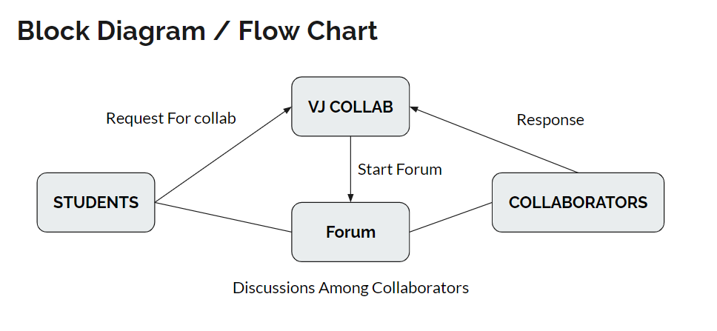
BLOCK DIAGRAM :

Slide 11
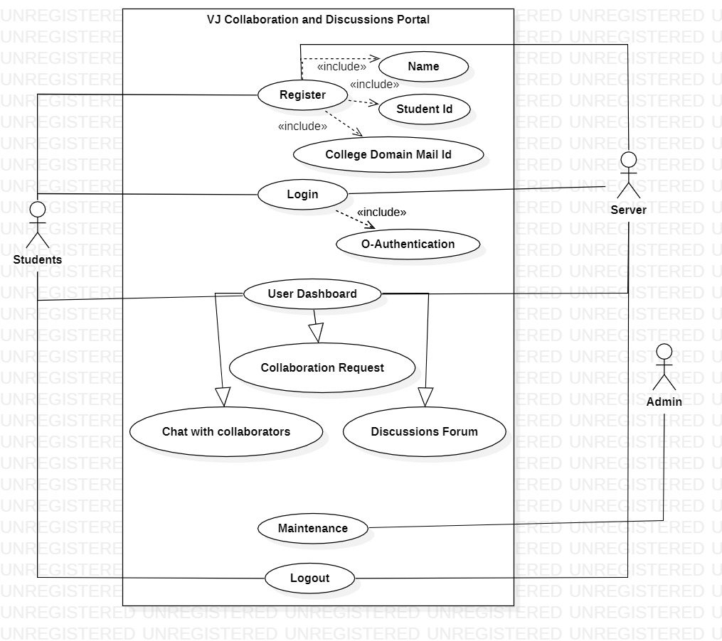
SYSTEM DESIGN :
Use-case diagram:

Slide 12
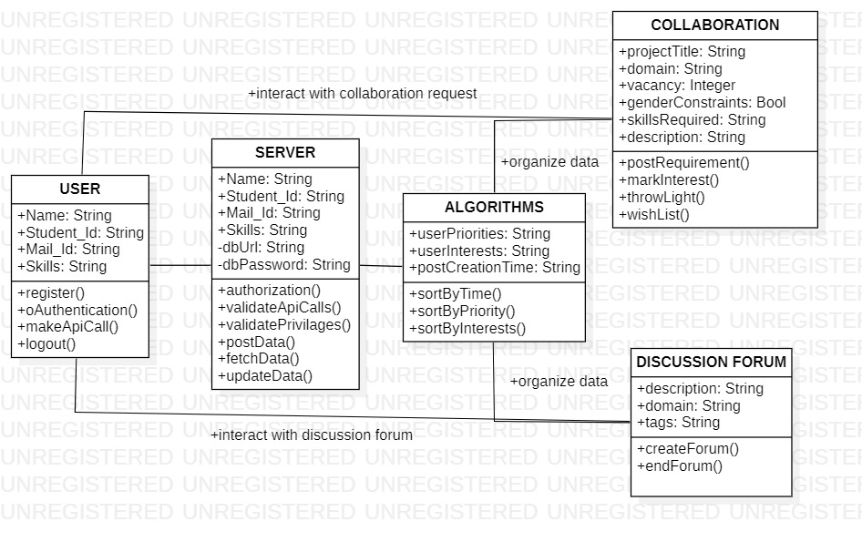
CLASS DIAGRAM :

Slide 13
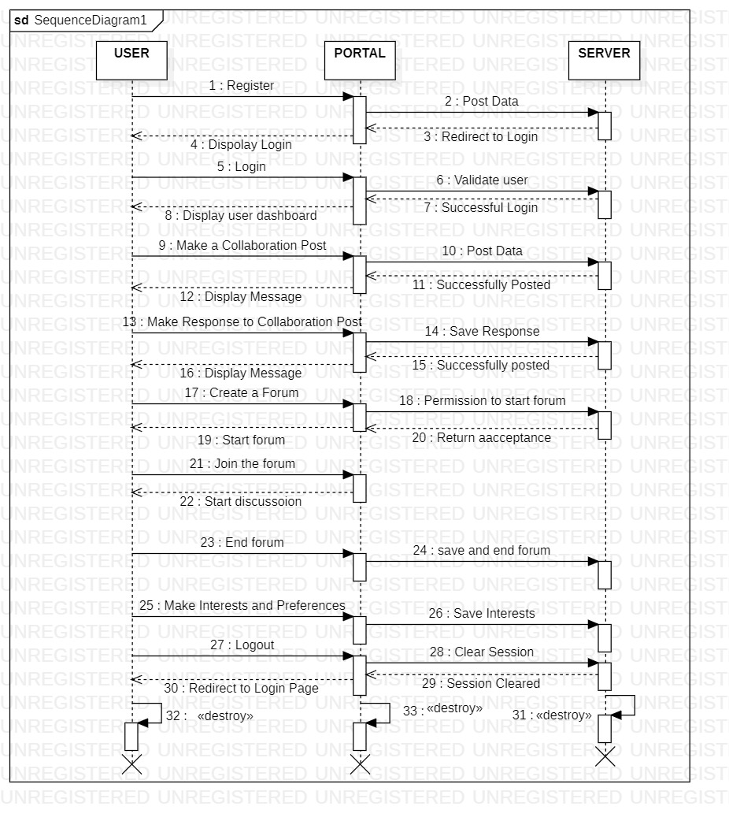
SEQUENCE DIAGRAM :

Slide 14
EVALUATION METRICS :
Increases productivity: Project collaboration tools allow project managers to evenly distribute tasks to team members, rather than burdening one team member with too much work. Proper task management gives teams more time, which facilitates team collaboration.
Boosts Team Communication: The lines of communication that need constant maintenance or misdirection can sidetrack a project. Project collaboration tools facilitate clear communication among your team members to make projects successful.
Facilitates Team Building: By fostering team collaboration you’re not only building relationships but creating loyalty that helps build a collaborative project management environment.
Firebase Data Analytics: The minimal and effective track of user actions and usage of this application is tracked on firebase analytics for application performance monitoring. Which can also be used to analyze user needs survives a a commercial need.

Slide 15
CONCLUSION
In this project, we have created a web application where students from VNR VJIET can form teams and find collaborators for their projects/hackathons. The website also allows users to post any technical/non-technical queries on the forum page where other students can respond.
The user also has a dashboard where he/she can accept/reject collab requests from various collaborators. By completing this project we have created a space in the VNR VJIET college where students can collaborate among themselves and also allow cross-domain projects.

